Slide 1
Chapter 3: Protecting Your Data and Privacy
Instructor Materials
Introduction to Cybersecurity v2.1
Notes:
Cisco Networking Academy Program
Introduction to Cybersecurity v2.1
Chapter 3: Protecting Your Data and Privacy

Slide 2
Instructor Materials – Chapter 3 Planning Guide
This PowerPoint deck is divided in two parts:
Instructor Planning Guide
Information to help you become familiar with the chapter
Teaching aids
Instructor Class Presentation
Optional slides that you can use in the classroom
Begins on slide # 9
Note: Remove the Planning Guide from this presentation before sharing with anyone.
Notes:
2

Slide 3
Chapter 3: Protecting Your Data and Privacy
Introduction to Cybersecurity v2.1 Planning Guide
Notes:
Cisco Networking Academy Program
Introduction to Cybersecurity v2.1
Chapter 3: Protecting Your Data and Privacy

Slide 4
Chapter 3: Activities
What activities are associated with this chapter?
Page # | Activity Type | Activity Name
3.1.1.5 | Lab | Create and Store Strong Passwords
3.1.2.3 | Lab | Back up Data to External Storage
3.1.2.5 | Lab | Who Owns Your Data?
3.2.2.3 | Lab | Discover your Own Risky Online Behavior
Notes:
4

Slide 5
Chapter 3: Assessment
Students should complete Chapter 3, “Assessment” after completing Chapter 3.
Quizzes, labs, and other activities can be used to informally assess student progress.
Notes:
5

Slide 6
Chapter 3: Best Practices
Prior to teaching Chapter 3, the instructor should:
Complete Chapter 3, “Assessment.”
Review the Additional Resources and Activities document in the Student Resources for possible additional resources and activities.
The objectives of this chapter are:
Explain how to protect your devices and network
Describe safe procedures for data maintenance.
Describe strong authentication methods
Describe safe online behaviors.
Notes:
6

Slide 7
Chapter 3: Additional Help
For additional help with teaching strategies, including lesson plans, analogies for difficult concepts, and discussion topics, visit the Community Forums .
If you have lesson plans or resources that you would like to share, upload them to the Community Forums in order to help other instructors.
Notes:
7

Slide 9
Chapter 3: Protecting Your Data and Privacy
Introduction to Cybersecurity v2.1
Notes:
Cisco Networking Academy Program
Introduction to Cybersecurity v2.1
Chapter 3: Protecting Your Data and Privacy

Slide 10
Chapter 3 - Sections & Objectives
3.1 Protecting Your Data
Explain how to protect devices from threats.
Explain how to protect your devices and network.
Describe safe procedures for data maintenance.
3.2 Safeguarding Your Online Privacy
Explain how to safeguard your privacy.
Describe strong authentication methods.
Describe safe online behaviors.
Notes:
10
Cisco Networking Academy Program
Introduction to Cybersecurity v2.1
Chapter 3: Protecting Your Data and Privacy

Slide 11
3.1 Protecting Your Data
Notes:
3 – Protecting Your Data and Privacy
3.1 – Protecting Your data

Slide 12

Protecting Your Devices and Network Protecting Your Computing Devices
Keep the Firewall On
Prevent unauthorized access to your data or computing devices
Keep the firewall up to date
Use Antivirus and Antispyware
Prevent unauthorized access to your data or computing devices
Only download software from trusted websites
Keep the software up to date
Manage Your Operating System and Browser
Set the security settings at medium or higher
Update your computer’s operating system and browser
Download and install the latest software patches and security updates
Protect All Your Devices
Password protect
Encrypt the data
Only store necessary information
IoT devices
Notes:
3.1 – Protecting Your Data
3.1.1 – Protecting Your Devices and Network
3.1.1.1 – Protect Your Computing Devices

Slide 13
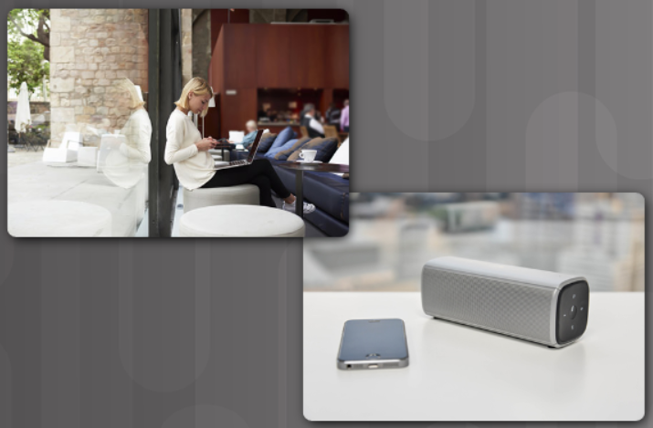
Protecting Your Devices and Network Use Wireless Networks Safely
Home Wireless Network
Change the pre-set SSID and default administrative password on your Wi-Fi router.
Disable SSID broadcast
Use WPA2 encryption feature
Be aware of WPA2 protocol security flaw – KRACK
Allows intruder to break the encryption between wireless router and clients
Use caution when using public Wi-Fi hotspots
Avoid accessing or sending sensitive information
Use of VPN tunnel can prevent eavesdropping
Turn off Bluetooth when not in use
Notes:
3.1 – Protecting Your Data
3.1.1 – Protecting Your Devices and Network
3.1.1.2 – Use Wireless Networks Safely

Slide 14
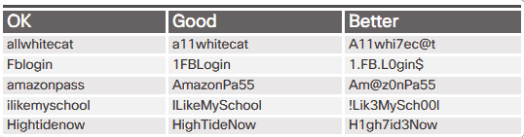
Protecting Your Devices and Network Use Unique Passwords for Each Online Account
Prevents criminals from accessing all your online accounts using one stolen credentials
Use password managers to help with remembering passwords
Tips for choosing a good password:
Do not use dictionary words or names in any languages
Do not use common misspellings of dictionary words
Do not use computer names or account names
If possible use special characters, such as ! @ # $ % ^ & * ( )
Use a password with ten or more characters
Notes:
3.1 – Protecting Your Data
3.1.1 – Protecting Your Devices and Network
3.1.1.3 – Use Unique Passwords for Each Online Accounts

Slide 15

Protecting Your Devices and Network Use Passphrase Rather Than a Password
Tips in choosing a good passphrase:
Choose a meaningful statement to you
Add special characters, such as ! @ # $ % ^ & * ( )
The longer the better
Avoid common or famous statements, for example, lyrics from a popular song
Summary of the new NIST guidelines:
8 characters minimum in length, but no more than 64 characters
No common, easily guessed passwords, such as password, abc123
No composition rules, such as having to include lowercase and uppercase letters and numbers
No knowledge-based authentication, such as information from shared secret questions, marketing data, transaction history
Improve typing accuracy by allowing the user to see the password while typing
All printing characters and spaces are allowed
No password hints
No periodical or arbitrary password expiration
Notes:
3.1 – Protecting Your Data
3.1.1 – Protecting Your Devices and Network
3.1.1.4 – Use Passphrase Rather Than a Password

Slide 16
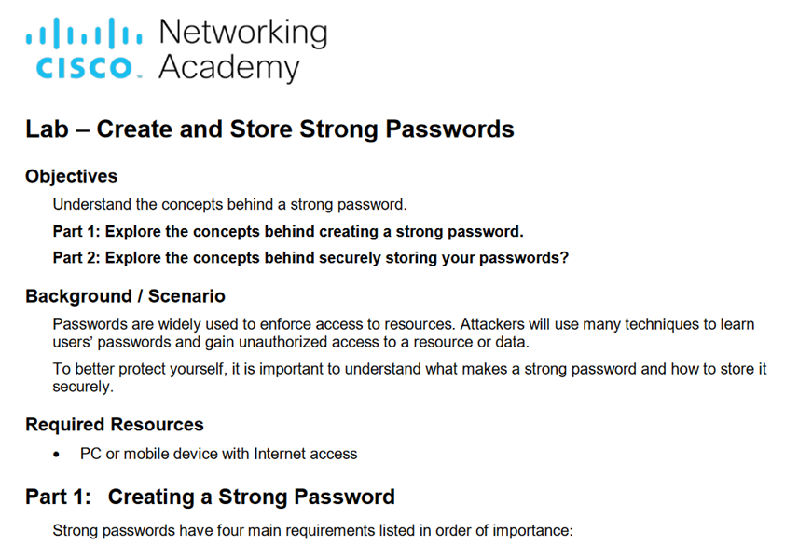
Protecting Your Devices and Network Lab – Create and Store Strong Passwords
Notes:
3.1 – Protecting Your Data
3.1.1 – Protecting Your Devices and Network
3.1.1.5 – Lab – Create and Store Strong Passwords

Slide 17
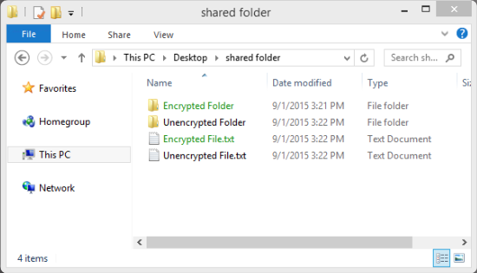
Data Maintenance Encrypt Your Data
Encrypted data can only be read with the secret key or password
Prevent unauthorized users from reading the content
What is Encryption?
process of converting the information into a form where an unauthorized party cannot read it
Notes:
3.1 – Protecting Your Data
3.1.2 – Data Maintenance
3.1.2.1 – Encrypt Your Data

Slide 18
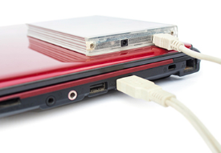

Data Maintenance Back up Your Data
Prevent the loss of irreplaceable data
Need additional storage location for the data
Copy the data to the backup location regularly and automatically
Local Backup
NAS, external hard drive, CDs/DVDs, thumb drives, or tapes
Total control and responsible for the cost and maintenance
Cloud Storage Service, such as AWS
Access to backup as long as you have access to your account
may need to be more selective about the data being backed up
Notes:
3.1 – Protecting Your Data
3.1.2 – Data Maintenance
3.1.2.2 – Back up Your Data

Slide 19
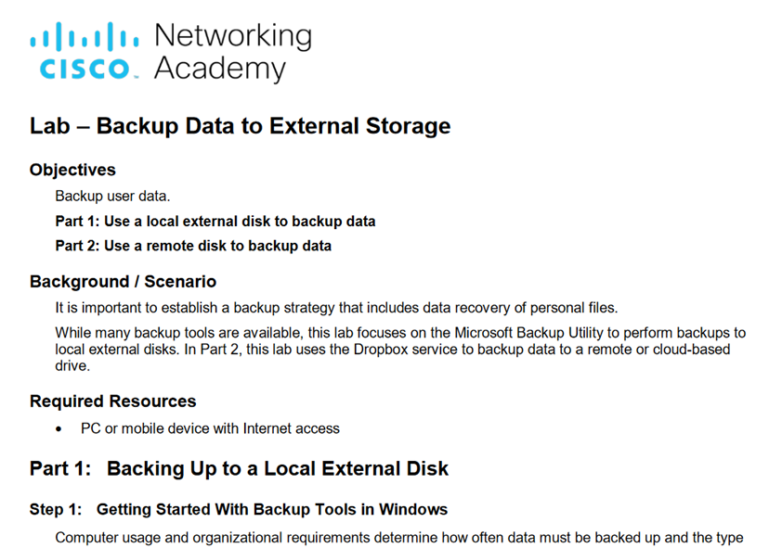
Data Maintenance Lab – Back up Data to External Storage
Notes:
3.1 – Protecting Your Data
3.1.2 – Data Maintenance
3.1.2.3 – Lab – Back up Data to External Storage

Slide 20
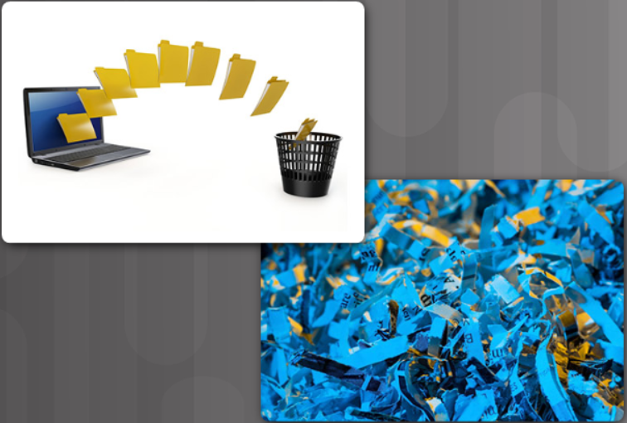
Data Maintenance Deleting Your Data Permanently
Use available tools to delete permanently: SDelete and Secure Empty Trash, for example
Destroy the storage device to ensure that the data is unrecoverable
Delete the online versions
Notes:
3.1 – Protecting Your Data
3.1.2 – Data Maintenance
3.1.2.4 – Deleting Your Data Permanently

Slide 21
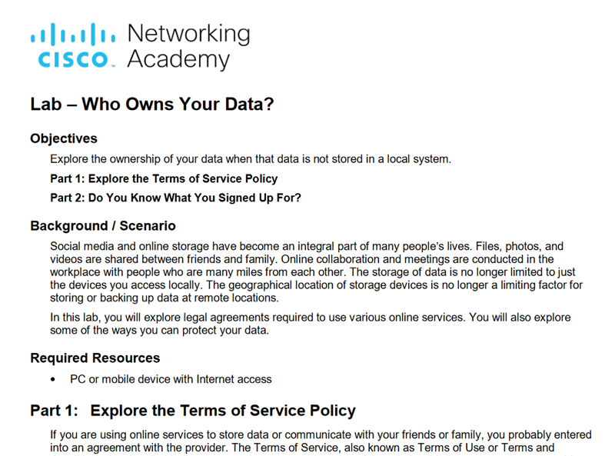
Data Maintenance Lab – Who Owns Your Data
Notes:
3.1 – Protecting Your Data
3.1.2 – Data Maintenance
3.1.2.5 – Lab – Who Owns Your Data

Slide 22
3.2 Safeguarding Your Online Privacy
Notes:
3 – Protecting Your Data and Privacy
3.2 – Safeguarding Your Online Privacy

Slide 23
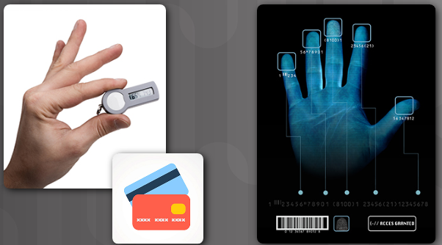
Strong Authentication Two Factor Authentication
Popular online services use two factor authentication
Need Username / password or PIN and a second token for access:
Physical object - credit card, ATM card, phone, or fob
Biometric scan - fingerprint, palm print, as well as facial or voice recognition
Notes:
3.2 – Safeguarding Your Online Privacy
3.2.1 – Strong Authentication
3.2.1.1 – Two Factor Authentication

Slide 24
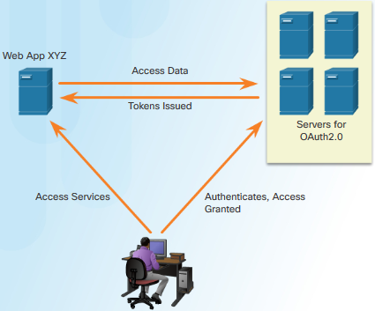
Strong Authentication OAuth 2.0
An open standard protocol that allows an end user’s credentials to access third party applications without exposing the user’s password
Act as the middle man to decide whether to allow end users access to third party applications.
Notes:
3.2 – Safeguarding Your Online Privacy
3.2.1 – Strong Authentication
3.2.1.2 – OAuth 2.0

Slide 25

Sharing Too Much Information? Do Not Share Too Much on Social Media
Share as little information as possible on social media
Do not share information such as:
Birth date
Email address
Phone number
Check your social media settings
Notes:
3.2 – Safeguarding Your Online Privacy
3.2.2 – Sharing Too Much Information?
3.2.2.1 – Do Not Share Too Much on Social Media

Slide 26

Sharing Too Much Information Email and Web Browser Privacy
Email is like sending a postcard.
Copies of the email can be read by anyone with access.
The email is passed among different servers
Use the private browsing mode can prevent other from gathering information about your online activities.
Private mode on popular browser
Microsoft Internet Explorer: InPrivate
Google Chrome: Incognito
Mozilla Firefox: Private tab / private window
Safari: Private: Private browsing
Notes:
3.2 – Safeguarding Your Online Privacy
3.2.2 – Sharing Too Much Information?
3.2.2.2 – Email and Web Browser Privacy

Slide 27
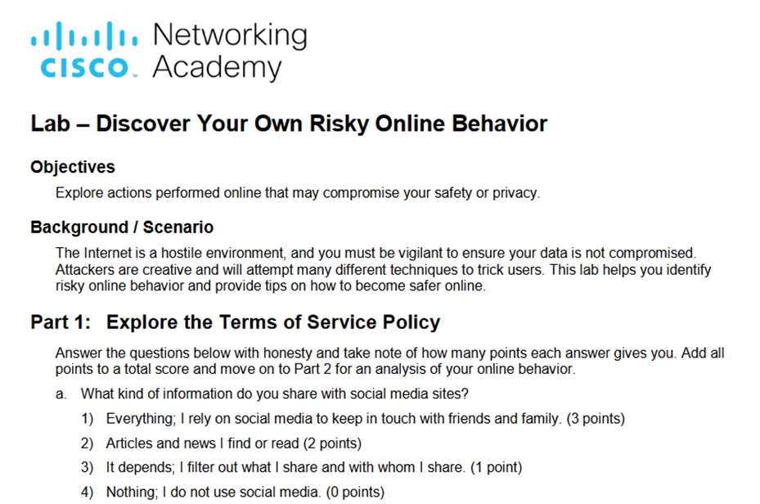
Sharing Too Much Information? Lab – Discover Your Own Risky Online Behavior
Notes:
3.2 – Safeguarding Your Online Privacy
3.2.2 – Sharing Too Much Information?
3.2.2.3 – Lab – Discover Your Risky Online Behavior

Slide 28
3.3 Chapter Summary
Notes:
3 – Protecting Your Data and Privacy
3.3 - Summary

Slide 29
Protecting Your Data and Privacy Summary
Explain how to protect your devices and network from threats.
Describe safe procedures for data maintenance.
Explain how to safeguard your privacy by using strong authentication methods and practicing safe online behaviors.
Notes:
3 – Protecting Your Data and Privacy
3.3 - Summary

